Slide 1
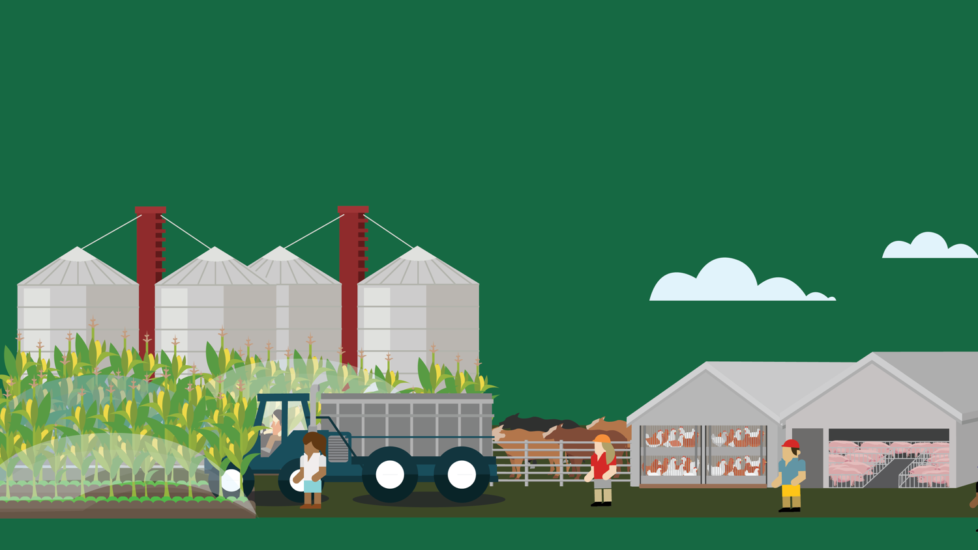
Lesson B
Industrialization of Agriculture
© 2020 Johns Hopkins University

Slide 2
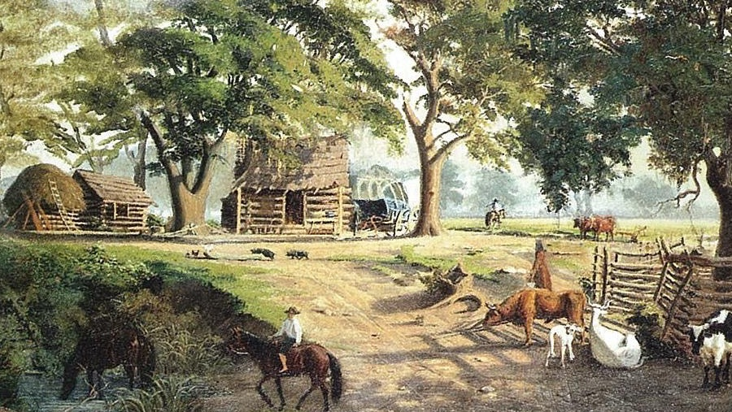
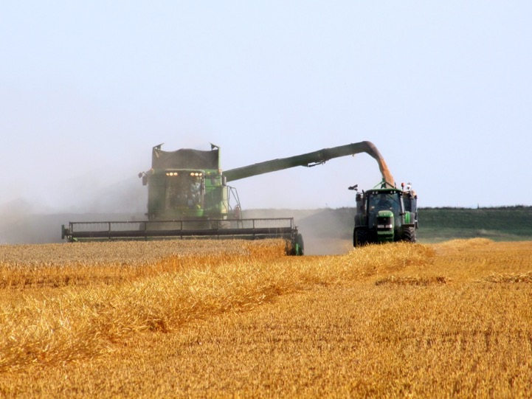
Farms, Then and Now
Photo credits: Carl G. von Iwonski. John Mack Farragher. Yeoman farm families. One Out of Many: A History of the American People, Pearson. 2011. Dan Davison. John Deere combine and tractor at work. Wikimedia Commons. Creative Commons CC BY 2.0.

Slide 3
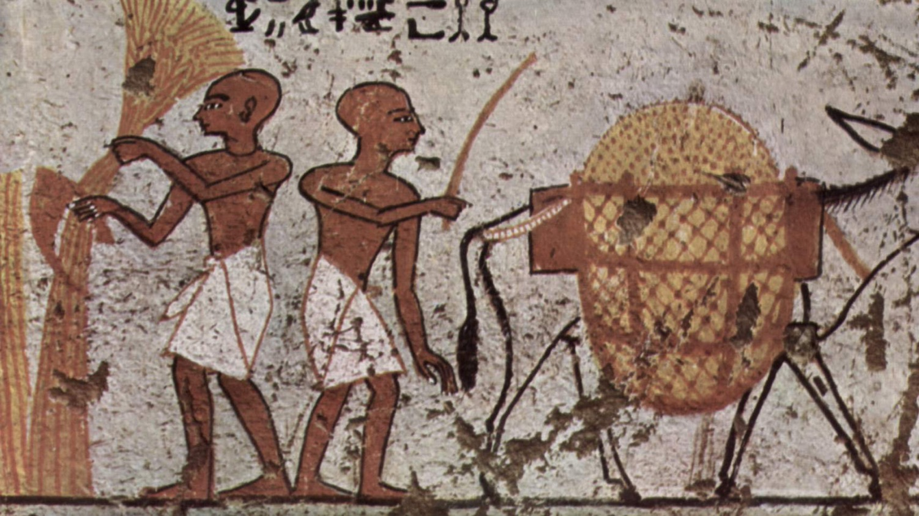
Agriculture
Timeline
Photo credit: Grave chamber of an Egyptian public official, circa 1250 BCE. Photo public domain.

Slide 4
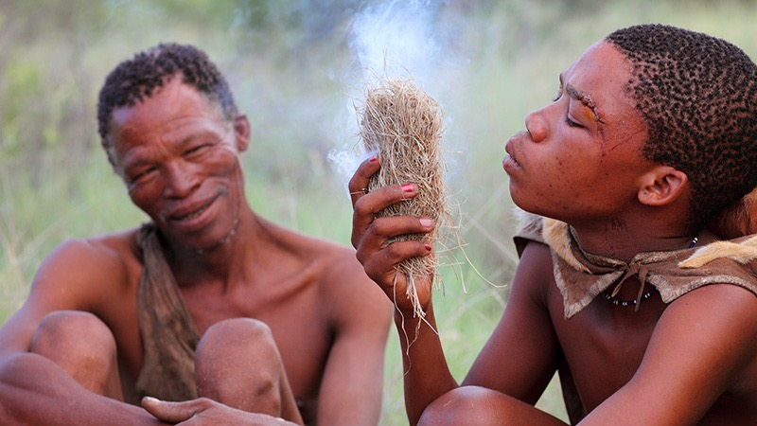
194,000 BCE
Photo credit: Dietmar Temps, 2010. Creative Commons CC BY-NC-SA 2.0.
Earliest evidence of Homo sapiens
For the vast majority of human history, food was acquired through hunting and gathering. Some peoples, such as the San (pictured), who live in Southern Africa, still follow a hunter-gatherer lifestyle.

Slide 5
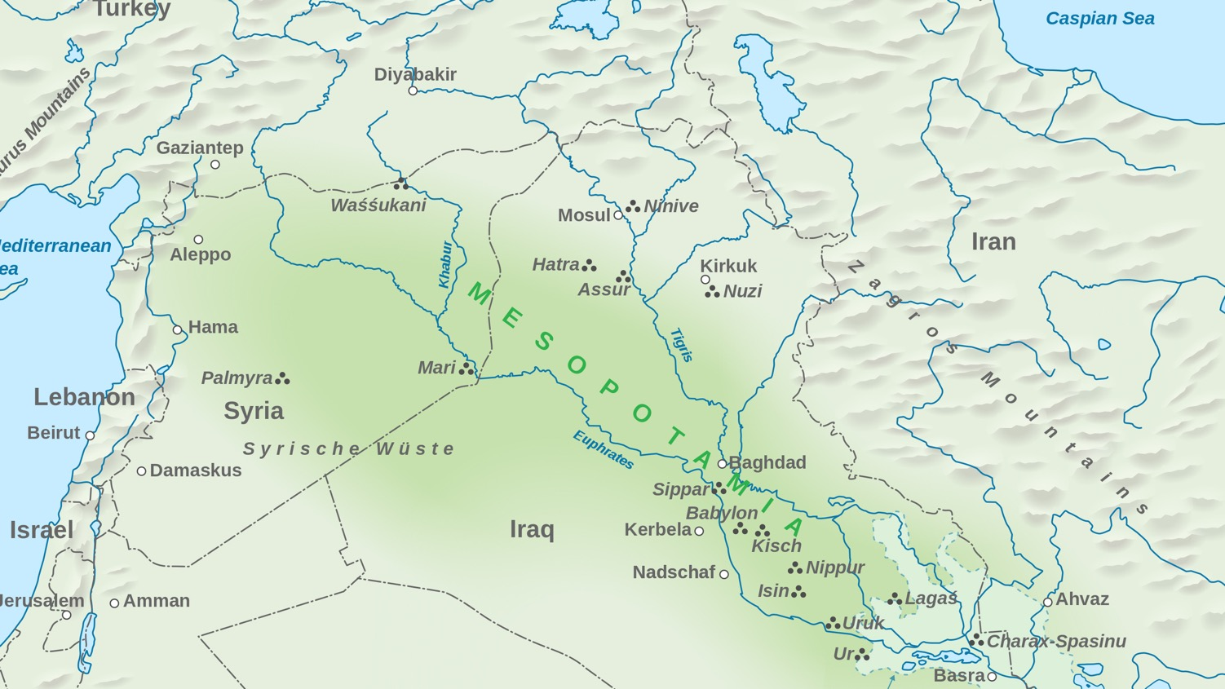
11,000 BCE
Image credit: Goran tek-en. Wikimedia Commons. Creative Commons CC BY-SA 3.0.
Earliest evidence of agriculture
The shift to agriculture is believed to have occurred independently in several parts of the world, including the Fertile Crescent (pictured), a region in the Middle East that cradled some of the earliest civilizations.

Slide 6
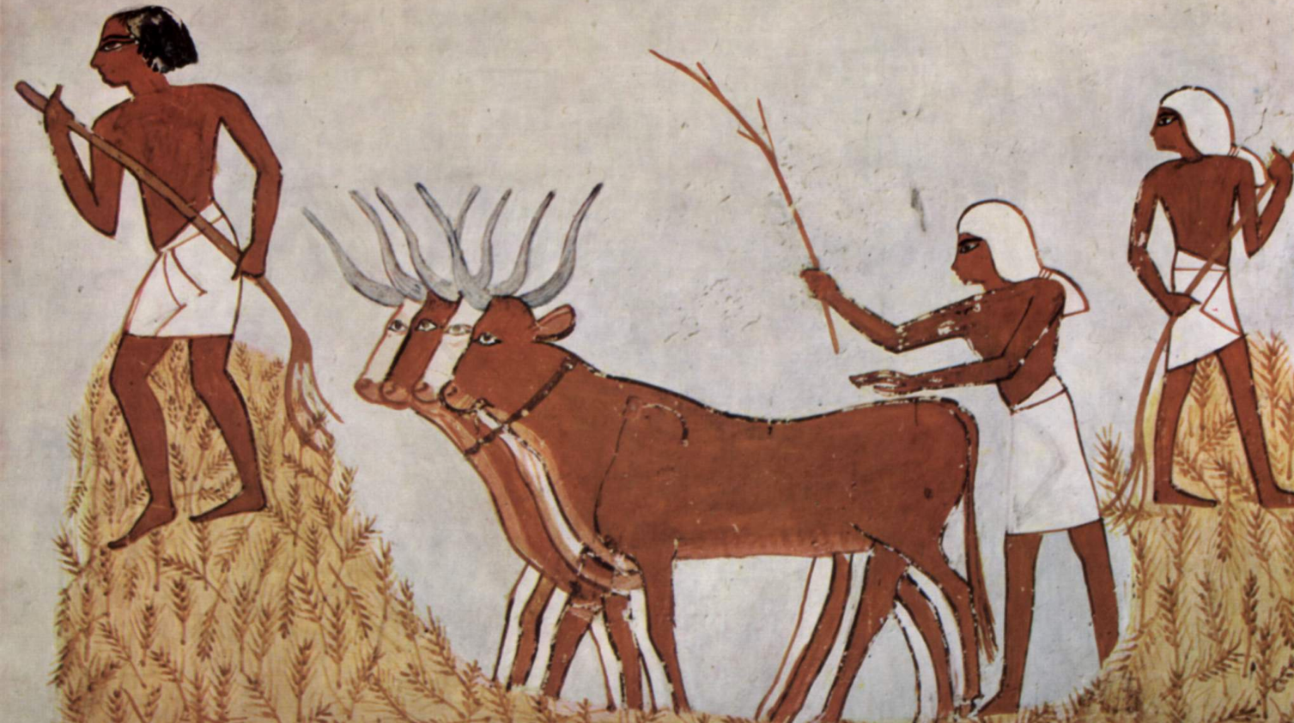
6,000 BCE
Photo credit: Maler der Grabkammer des Menna. Wikimedia Commons. Public domain.
Most species of farm animals domesticated

Slide 7
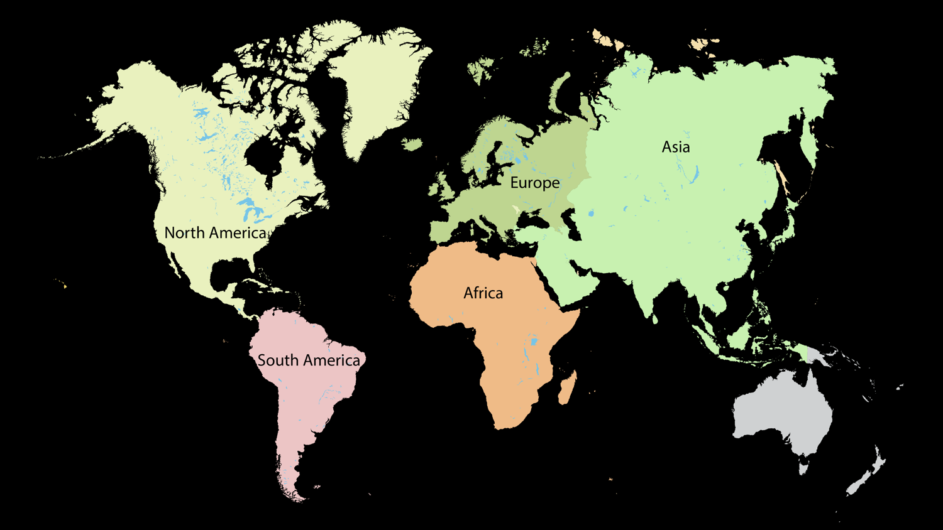
5,000 BCE
Agriculture practiced on every major continent except Australia

Slide 8
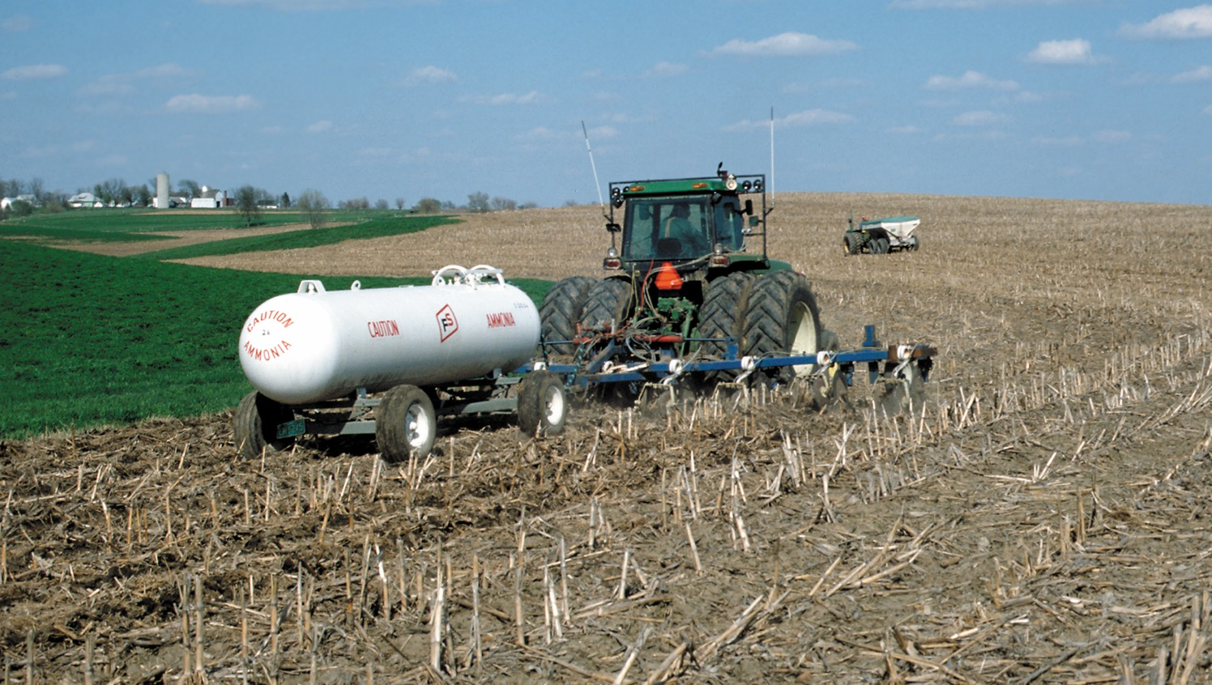
1900s
Photo credit: Lynn Betts, USDA Natural Resource Conservation Service.
Widespread adoption of industrial agriculture
Synthetic nitrogen fertilizers (pictured), introduced in the 1900s, have been credited with providing the lion’s share of the world’s food over the 20th century. Pesticides and monocultures are also hallmarks of industrial agriculture.

