Slide 1
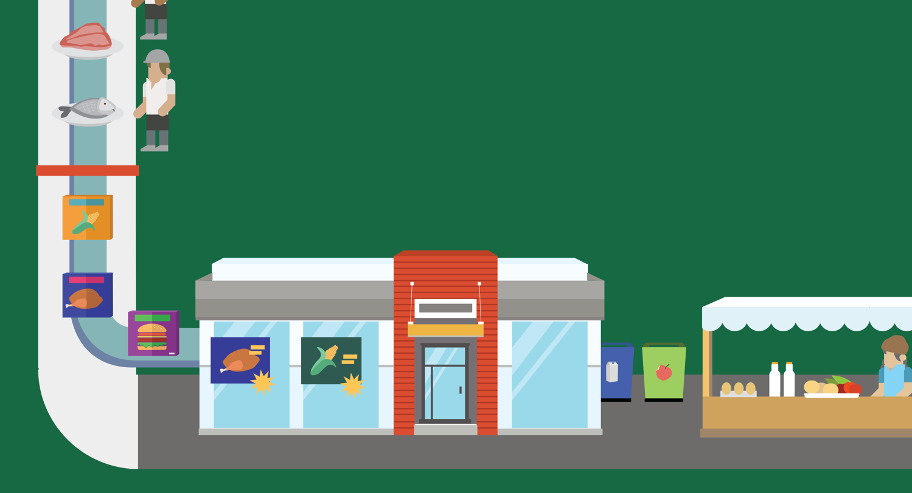
Lesson 13
Our Wasted food
© 2020 Johns Hopkins University

Slide 2
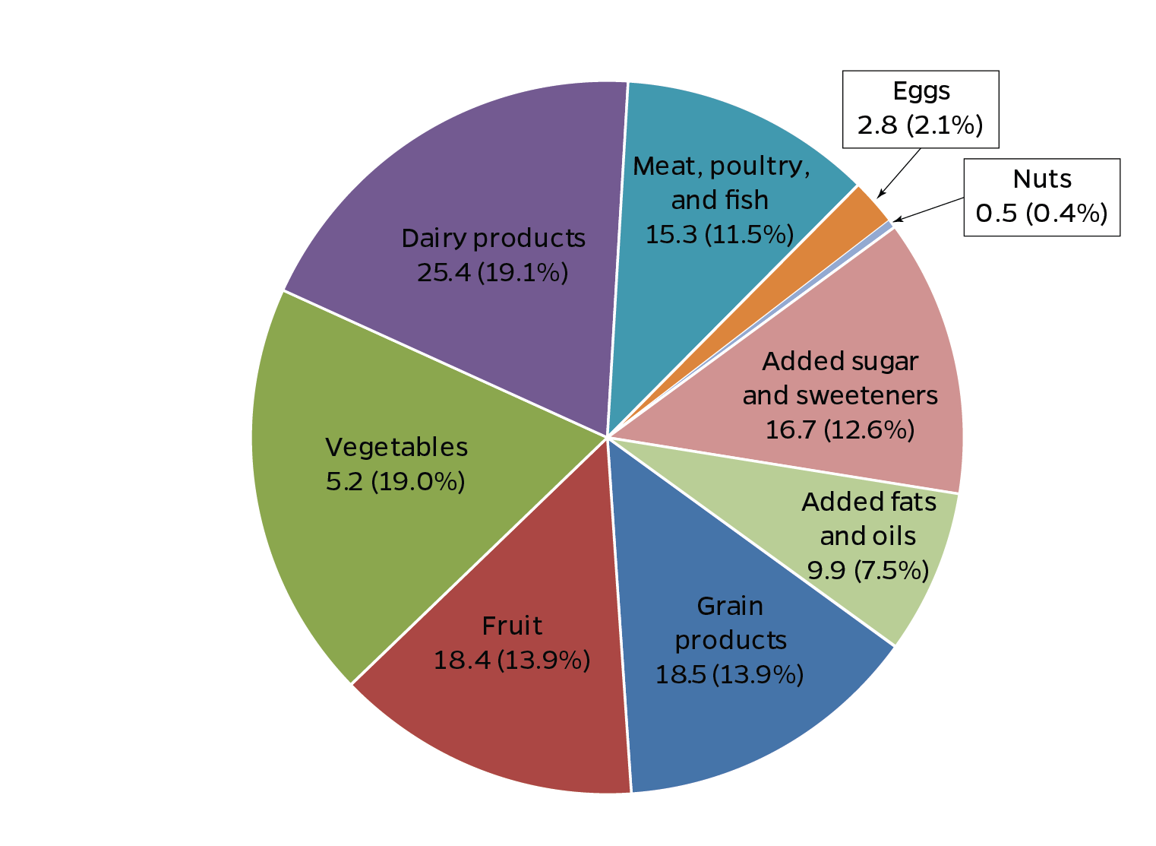
Waste by Food Group
U.S. food waste, in billions of pounds, 2010
Data source: Buzby JC, Wells HF, Hyman J. The Estimated Amount, Value, and Calories of Postharvest Food Losses at the Retail and Consumer Levels in the United States. USDA ERS; 2014.
Photo credit: Michael Milli, CLF.

Slide 3
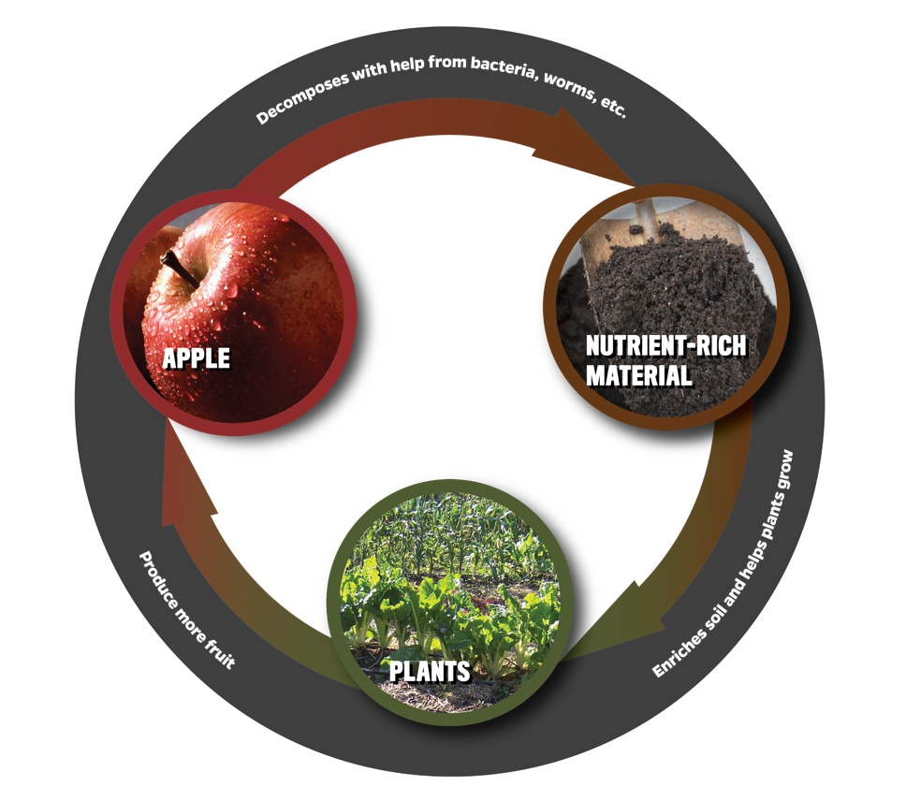
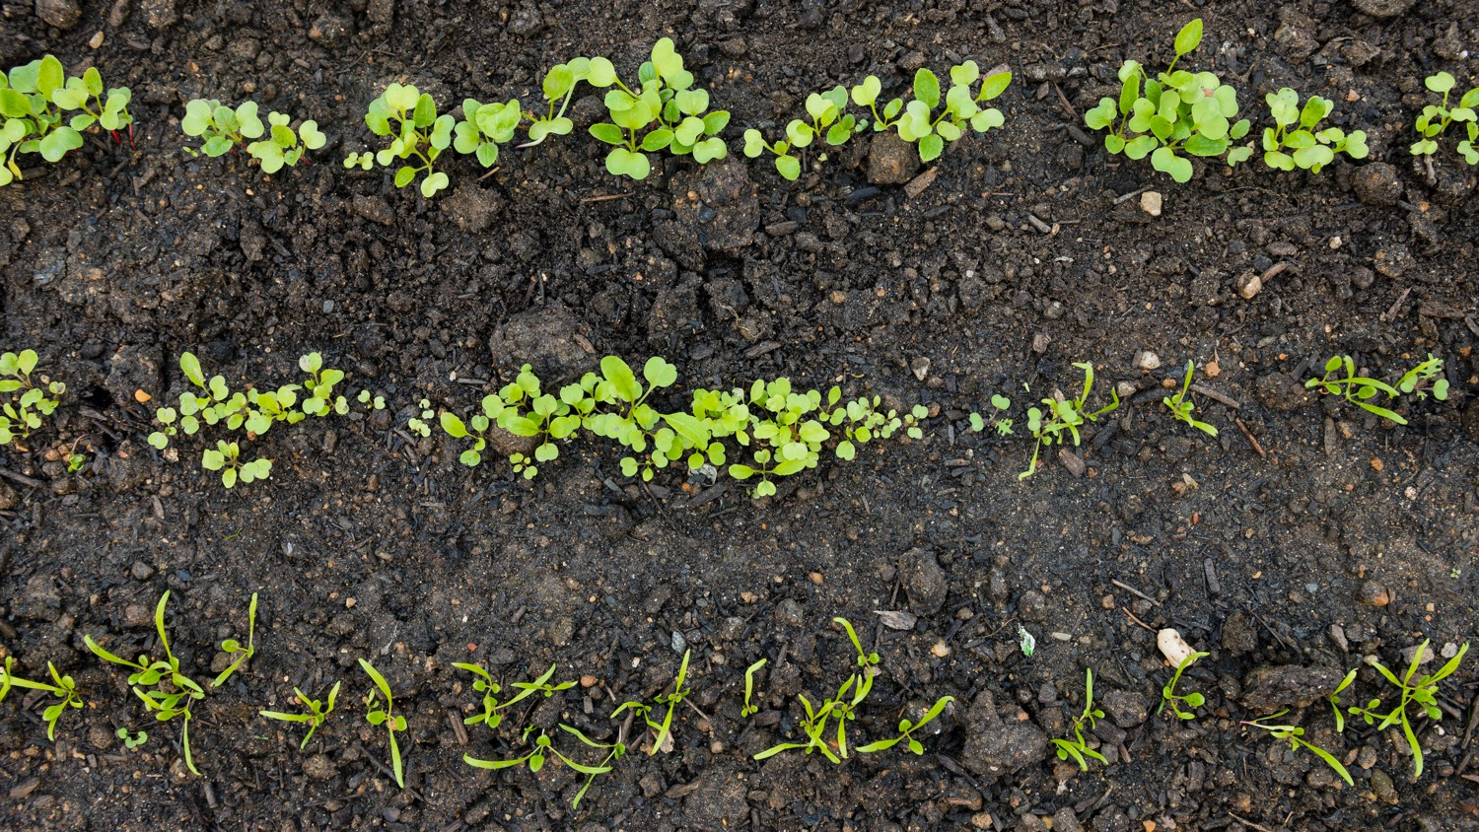
Nutrient Cycle
Photo credit (apple): Scott Bauer, USDA ARS.

Slide 4
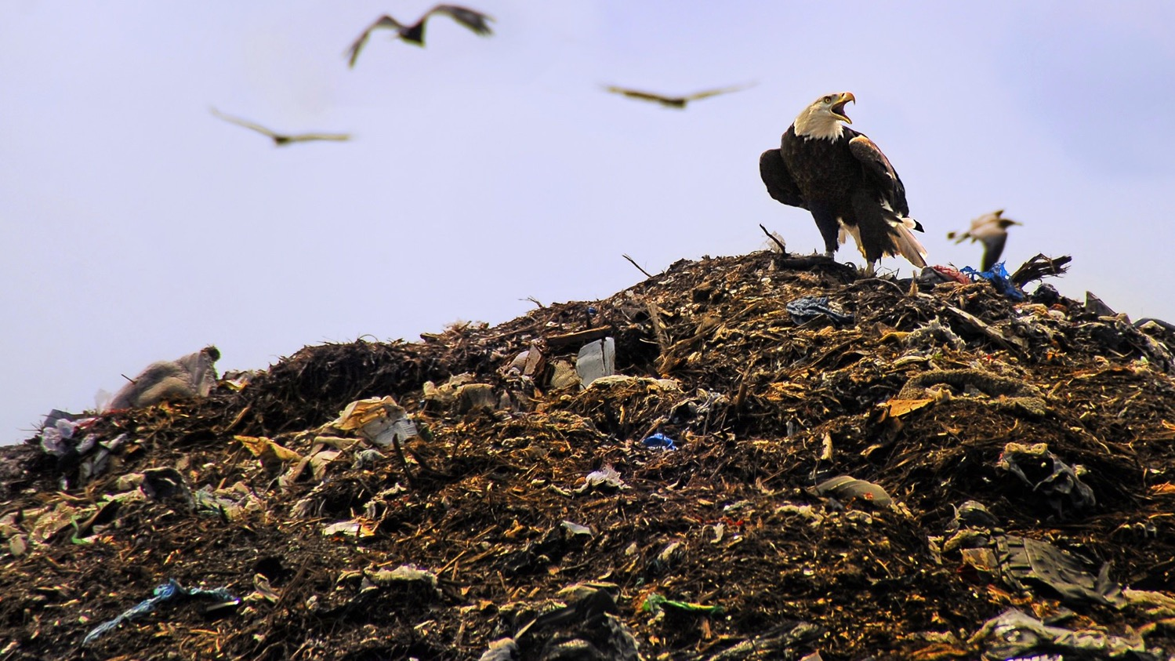
Landfills
Food represents the single largest component (21%) of solid waste in landfills and incinerators.
Source: U.S. Environmental Protection Agency. Reducing Food Waste for Business. 2014.
Photo credit : Andrea Westmoreland, 2008. Wikimedia Commons. Creative Commons CC BY-SA 2.0 . http://creativecommons.org/licenses/by-sa/2.0/deed.en

Slide 5
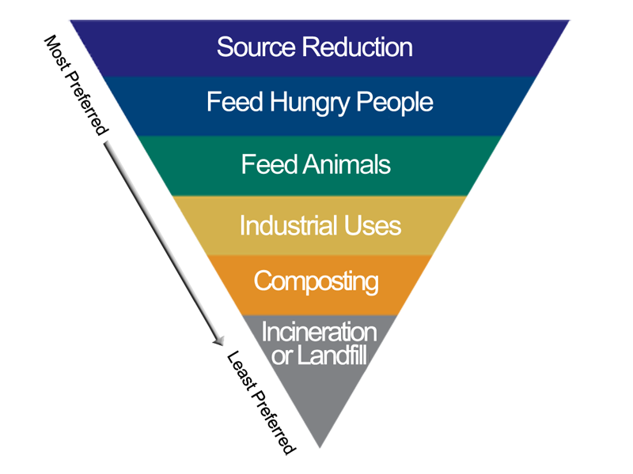
EPA Food Recovery Hierarchy
United States Environmental Protection Agency. https://www.epa.gov/sustainable-management-food/food-recovery-hierarchy
Photo credit: Michael Milli, CLF.

