Slide 1
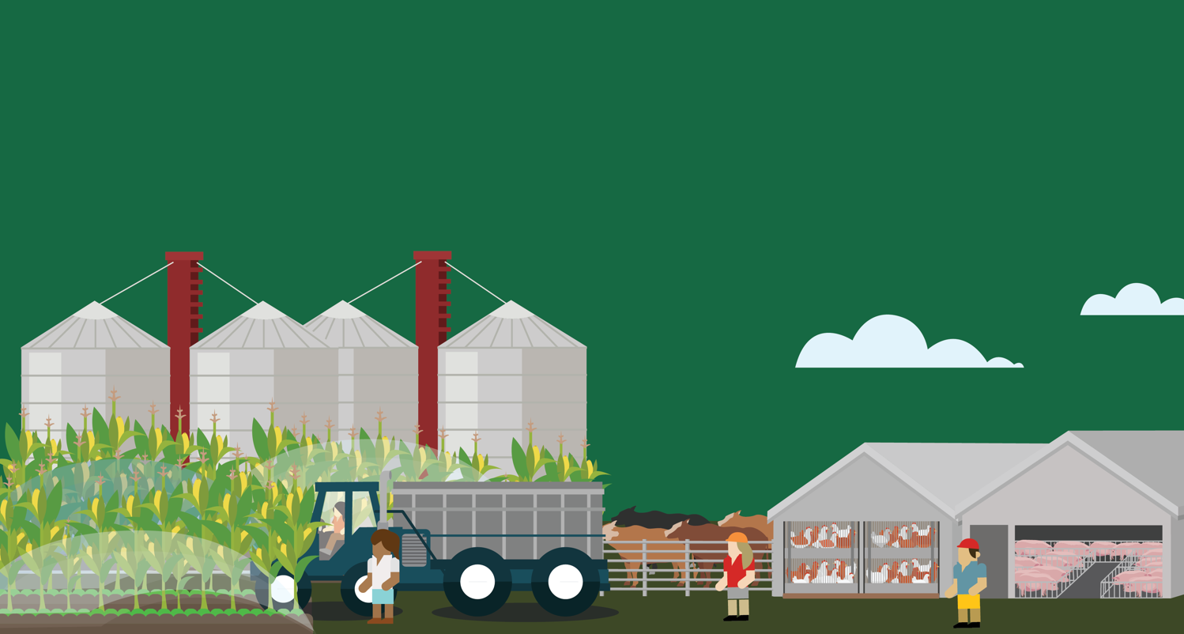
Lesson 1
Crops: Growing Problems
© 2020 Johns Hopkins University

Slide 2
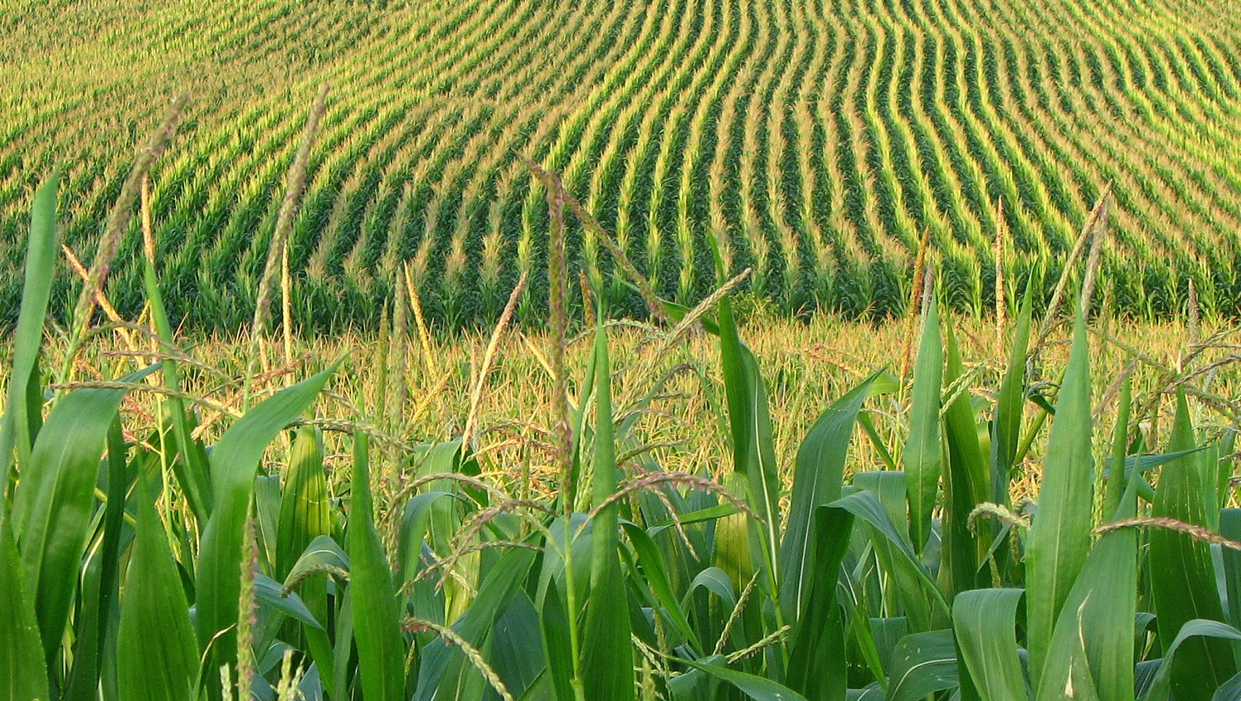
Monoculture
Fishawk. "Corn Field." Flickr, 2010. Creative Commons CC BY 2.0.

Slide 3
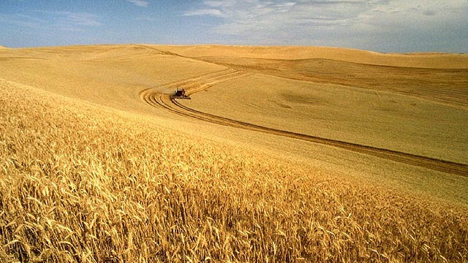
Monoculture
What Harvest in Idaho. USDA. Public domain.

Slide 4
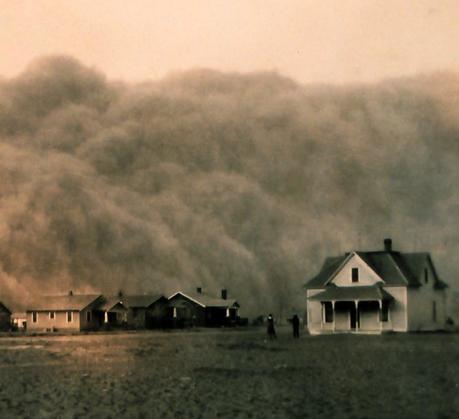
Ecological Impacts
Potential ecological impacts of industrial crop production:
Soil erosion
Decrease in bee populations
Emergence of pesticide-resistant weeds
Aquatic dead zones
Depletion of phosphorous and fossil fuels
Depletion of groundwater
The 1930s Dust Bowl demonstrated the devastating potential of soil erosion. See the Crop Production primer for details. Photo credit: NOAA, 1935. Public domain.

