Slide 1
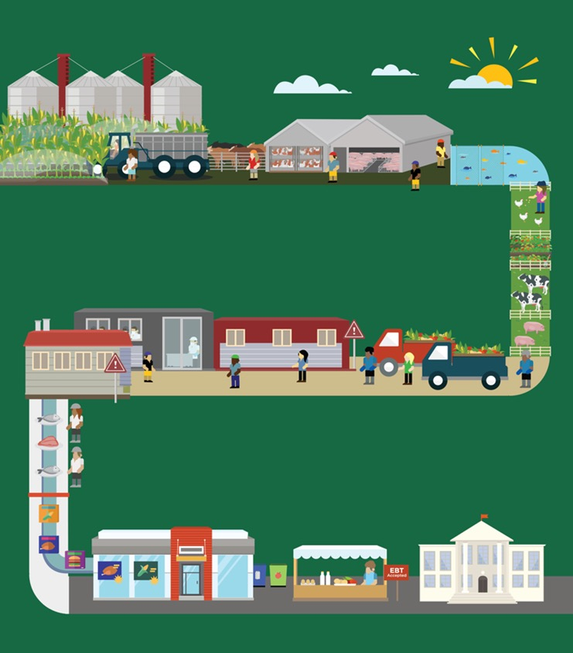
Lesson A
Exploring the Food System
© 2020 Johns Hopkins University

Slide 2
FoodSpan Infographic
Crop production
Food animal production
Seafood production
Food chain workers
Climate change
Agroecology
Food distribution
Food safety
Food processing
Food labeling
Food marketing
Food environments
Food waste
Hunger and food insecurity
Food policy

Slide 3
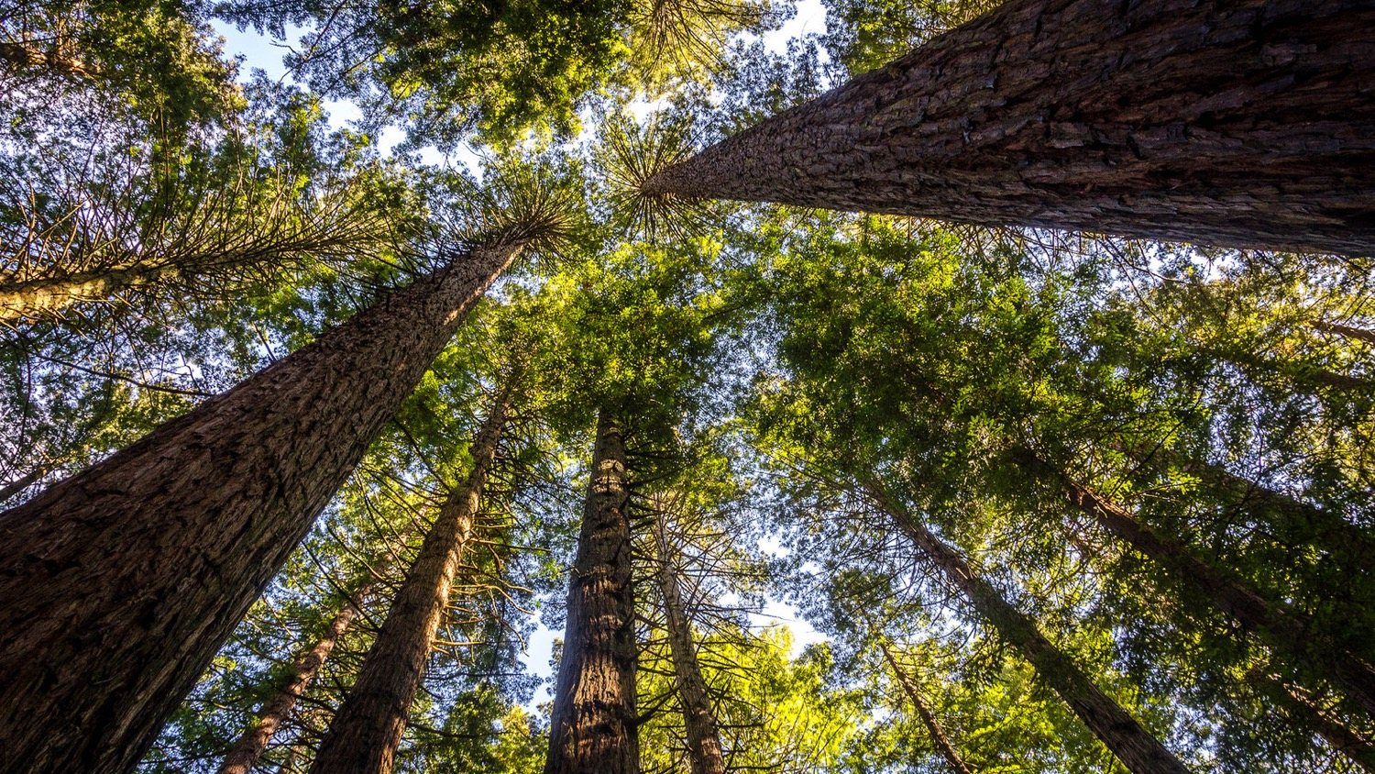
John Muir quote
“When we try to pick out anything by itself, we find it hitched to everything else in the universe.” – John Muir
Photo credit: Kathrin & Stefan Marks. Redwood Forest Morning. Flickr. Creative Commons CC BY-NC-ND 2.0.

Slide 4
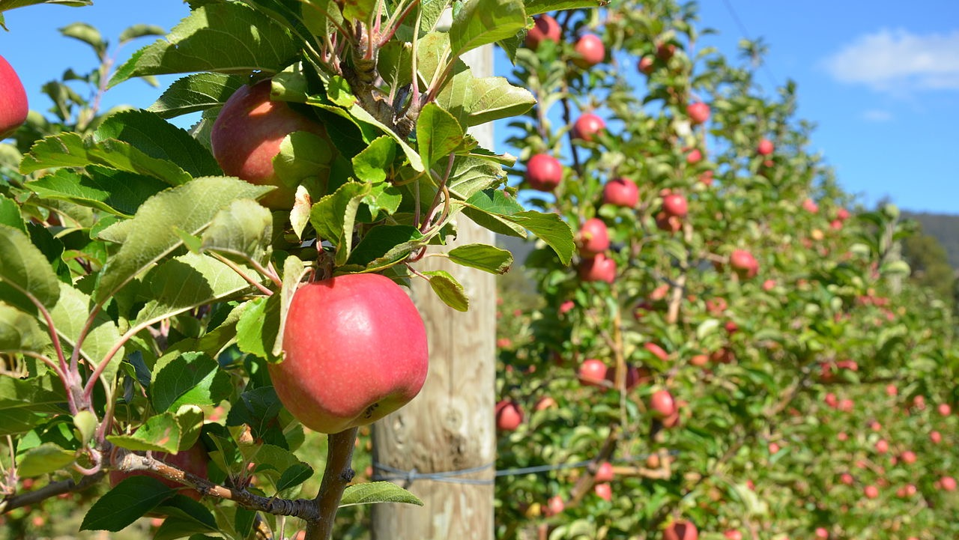
Washington Apple Supply Chain
Growing Apples grow on trees in orchards
Harvesting Apples are picked by hand
Washing, grading, waxing A wax coating helps keep apples crisp
Packing Apples are sorted and packed into 40-pound cartons
Retailing Apples are sold in a variety of stores
Packaging Packaging depends on how the apples are processed, if at all
Processing Some apples may be canned or made into applesauce, pie filling, etc.
Distributing Apples are transported up to thousands of miles in refrigerated trucks
Preparing Apples can be eaten whole, added to salads, cooked in pies, etc.
Consuming Apples are eaten
Disposing Throughout the life cycle, some apples and parts of apples are discarded
Composting Discarded apples can be composted and used to help more apples grow
Adapted, with permission, from Discovering the Food System. www.hort.cornell.edu/foodsys/. Photo credit: Apple and Pear Australia Ltd. Flickr. Creative Commons CC-BY 2.0.

Slide 5
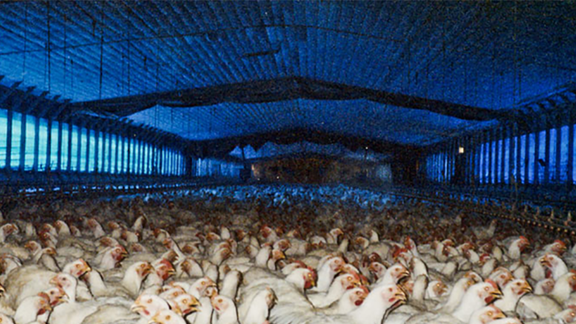
Broiler Chicken Supply Chain
Soy growing
Soy harvesting
Chick hatchery producing
Poultry feed processing
Corn growing
Corn harvesting
Poultry feed processing
Poultry feed processing
Poultry producing
Poultry producing
Poultry producing
Poultry producing
Fish harvesting
This example represents the prevailing industrial model of poultry production in the U.S.
Distribution steps not shown. Adapted from Pelletier N. Environmental performance in the US broiler poultry sector: Life cycle energy use and greenhouse gas, ozone depleting, acidifying and eutrophying emissions. Agricultural Systems, 2008; 98, 67-73. Photo credit: Farm Sanctuary. www.farmsanctuary.org.

Slide 6
Broiler Chicken Supply Chain (continued)
Processing
Retailing
Preparing
Consuming
In this example, the chicken is minimally processed. Foods such as chicken nuggets would require additional processing steps.
Distribution steps not shown. Adapted from Pelletier N. Environmental performance in the US broiler poultry sector: Life cycle energy use and greenhouse gas, ozone depleting, acidifying and eutrophying emissions. Agricultural Systems, 2008; 98, 67-73. Photo credit: Farm Sanctuary. www.farmsanctuary.org.

