Slide 1
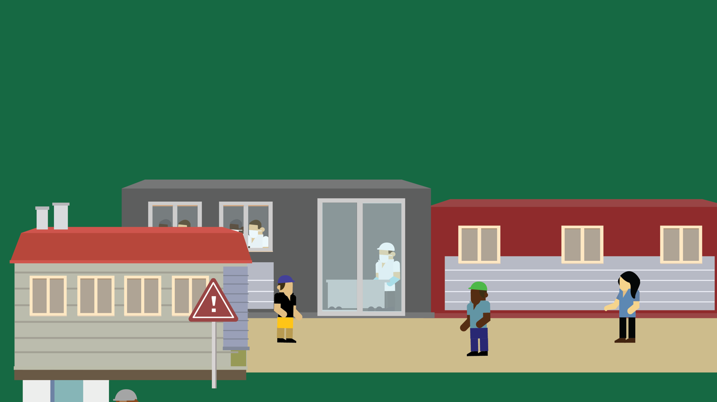
Lesson 8
Keeping Our Food Safe
© 2020 Johns Hopkins University

Slide 2
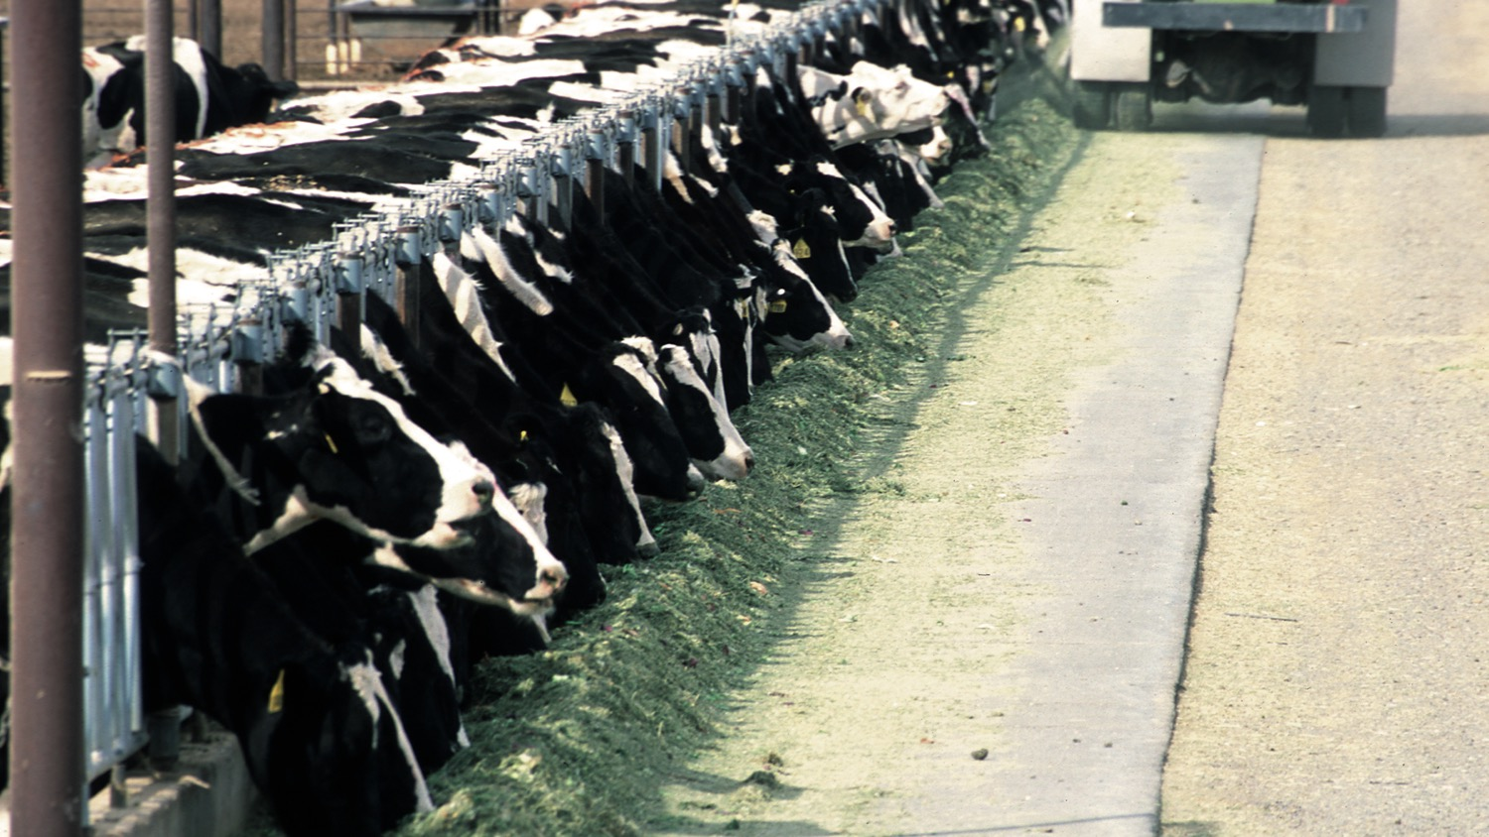
Cattle Diets and Pathogens
Grasses are the natural diet of cattle.
Feeding them grain changes their gut environment in ways that increase populations of certain pathogens.
Photo credit: Vanuga, Jeff. USDA National Resource Conservation Service, 2012.

Slide 3
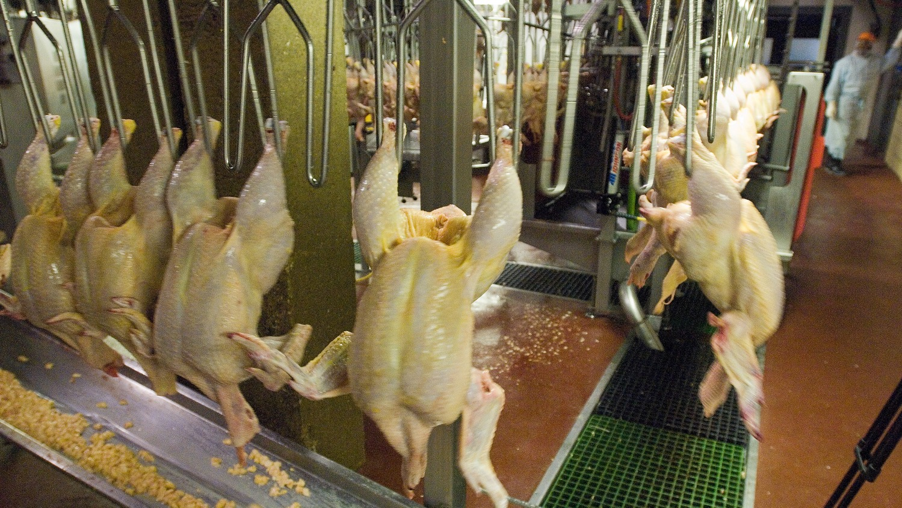
Poultry processing
Poultry processing plants can operate at very high speeds – up to 140 birds per minute.
This allows just seconds to identify and remove contaminated carcasses before they enter the food supply.
Photo credit: USDA, 2006. Creative Commons CC BY 2.0. https://www.flickr.com/photos/usdagov/7008322305

Slide 4
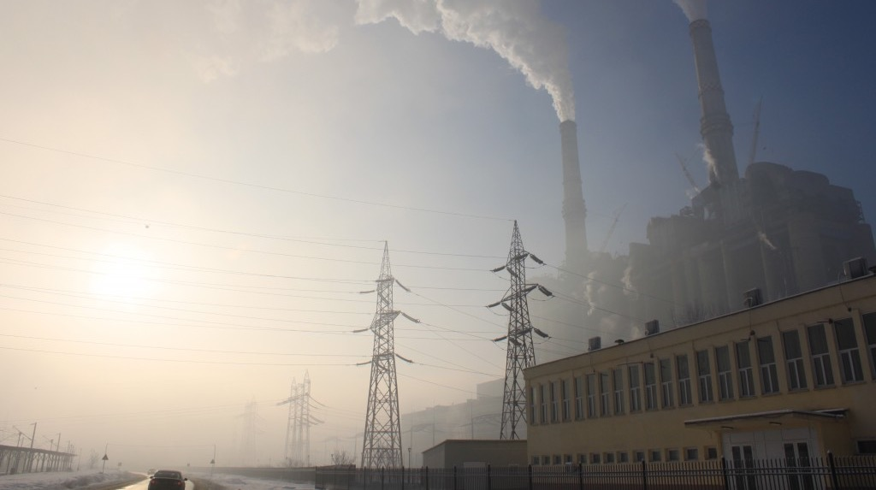
Chemical emissions
Industries such as mining, coal burning, and manufacturing release chemicals into air, water, and soil.
These chemicals can make their way into our food supply.
Emissions from a coal-fired power plant. Emilian Vicol. Public domain.

Slide 5
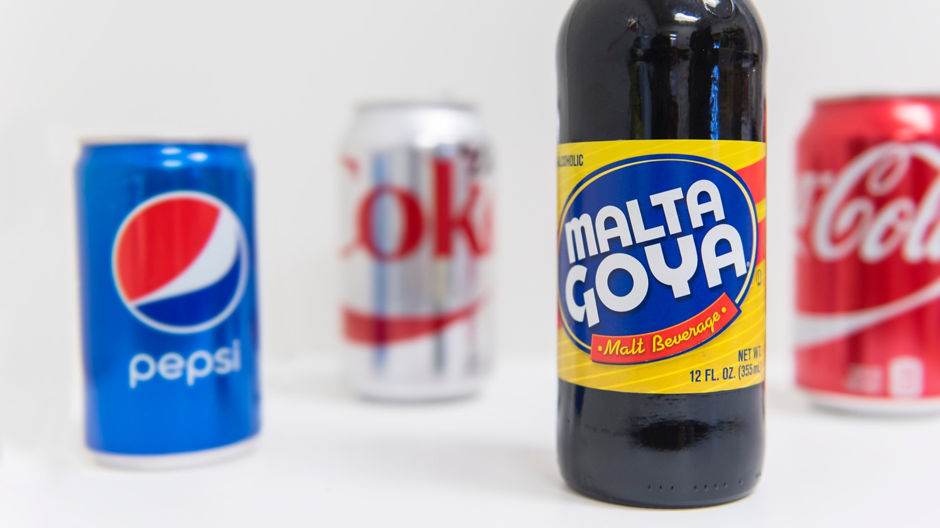
Chemicals in food
Some potentially harmful chemicals, such as some caramel color in soft drinks, are present in food or beverages because manufacturers add them directly to products.
Photo credit: Michael Milli, CLF.

Slide 6
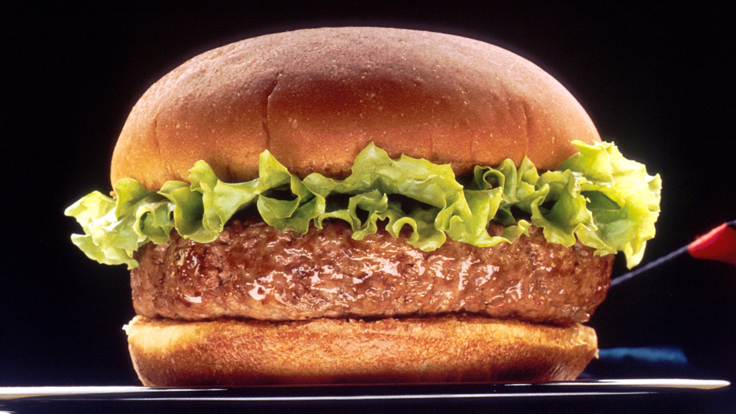
Pesticides persist!
Some pesticides persist in the environment and can accumulate in animals, contaminating meat and seafood.
FLIT (DDT) advertisement: Dr. Seuss Collection, Special Collections & Archives, University of California, San Diego. Used with permission. http://library.ucsd.edu/speccoll/dsads/index.html#ark:bb48133018.
Hamburger: Len Rizzi. National Cancer Institute, 1990. Public domain.

