Slide 1
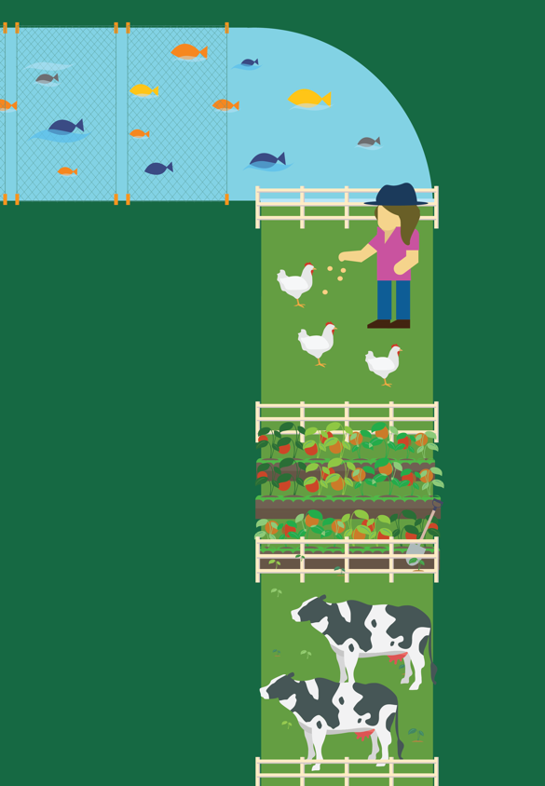
Lesson 6
Turning Toward Sustainability
© 2020 Johns Hopkins University

Slide 2
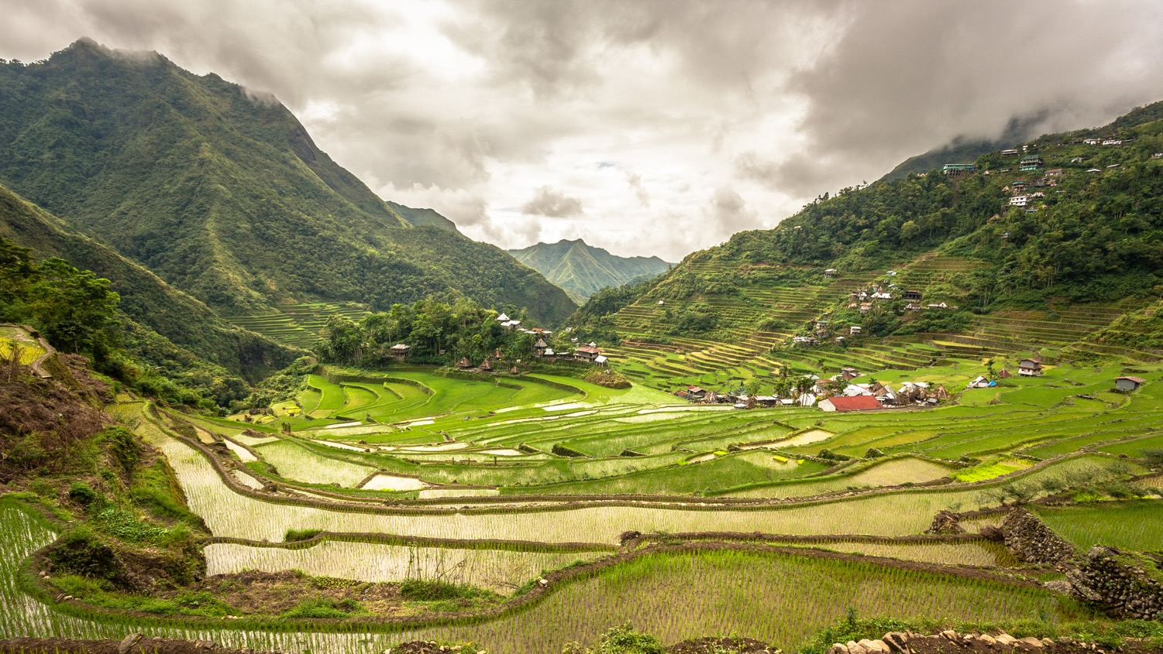
Sustainable
Ecologically sound
Economically viable
Socially just
Photo credit: Adi.simionov. Batad rice terraces. Wikimedia Commons. Creative Commons CC BY-SA 3.0.

Slide 3
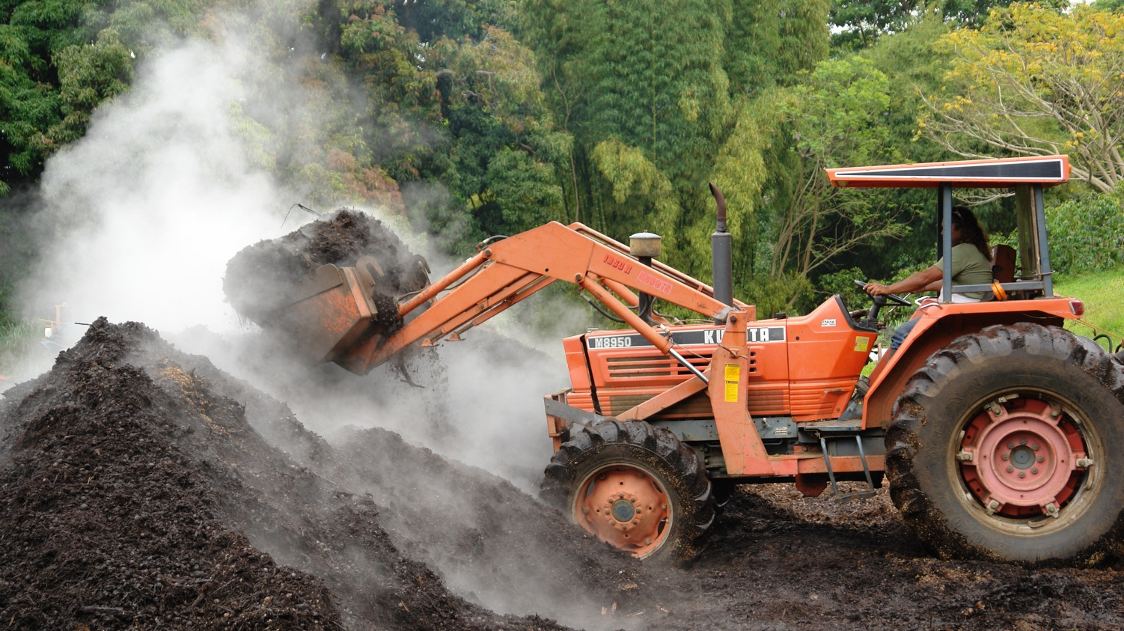
Efficiency
Agroecology recycles and reuses resources whenever possible, just as natural systems continually recycle rainfall and organic matter.
Composting (pictured) recycles organic matter, converting waste into fertilizer to help crops grow.
Photo credit: Scot Nelson. Composting at a Kona coffee farm: turning the pile. Flickr. Creative Commons CC BY-SA 2.0.

Slide 4
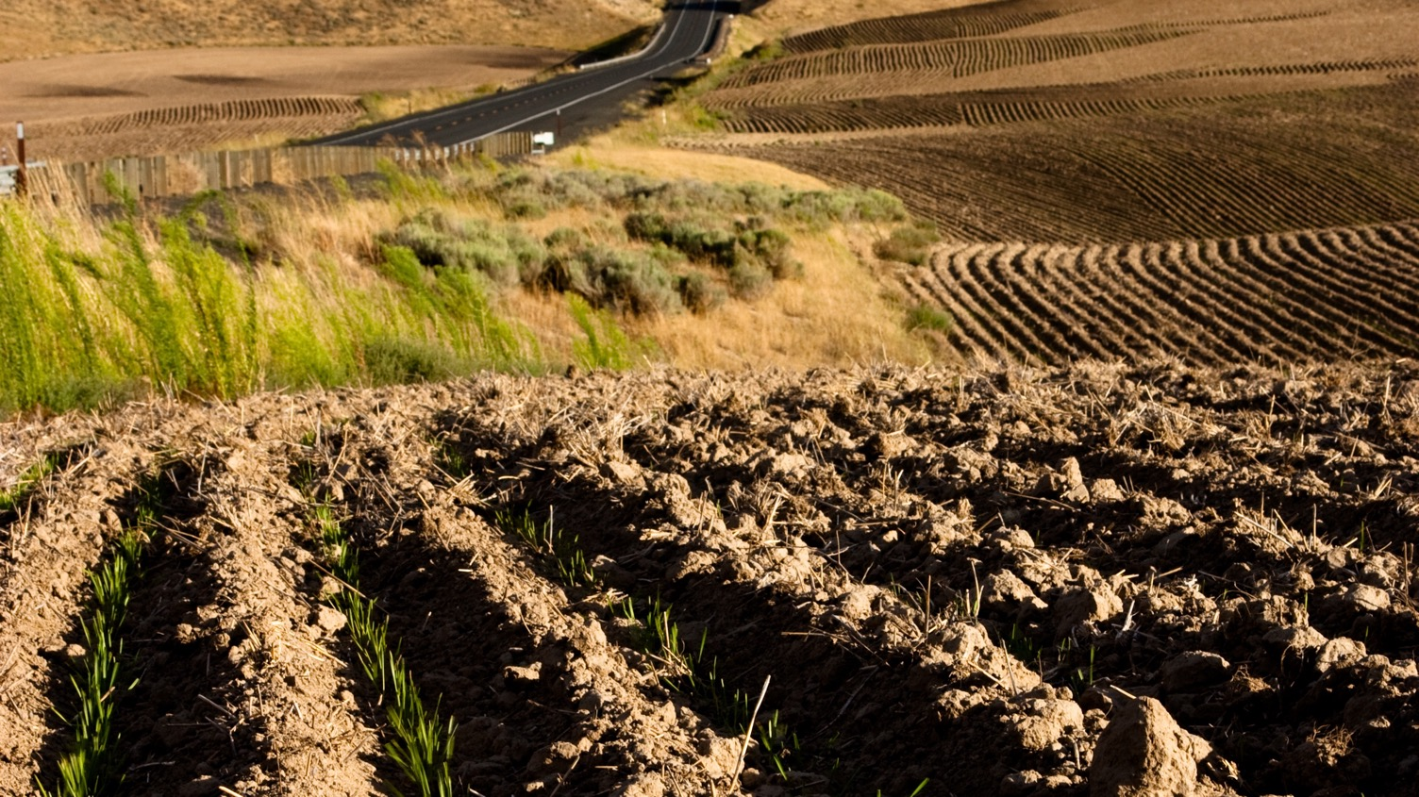
Self-sufficiency
Agroecology requires minimal inputs beyond what Nature already provides (sunlight, soil, water, and biodiversity).
Dryland farming (pictured) relies exclusively on rainwater and soil moisture.
Photo credit: Chris Devaraj. Palouse hills, Washington. Wikimedia Commons. Creative Commons CC BY 2.0.

Slide 5
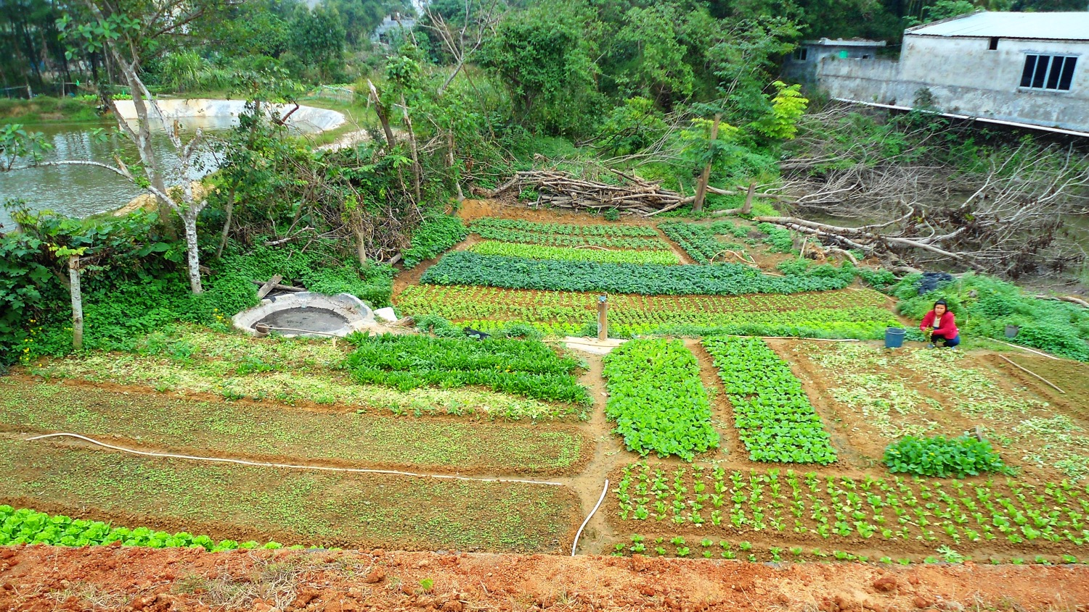
Diversity
Agroecology makes use of many different species of plants and animals on the same farm, and benefits from their interactions.
Growing a variety of different crops (pictured) and rotating them over time helps control pests.
Photo credit: Anna Frodesiak. A small vegetable farm in rural Hainan Province, China. Public domain.

Slide 6
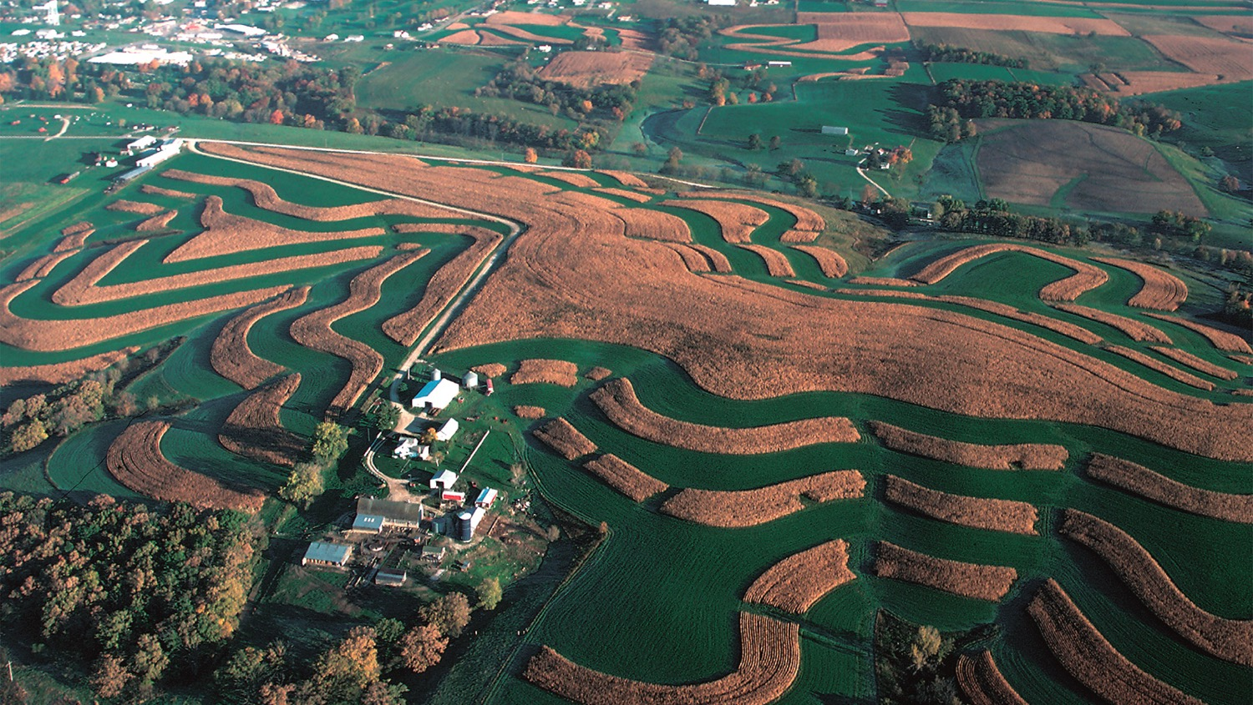
Resilience
Agroecology can better withstand and recover from shocks like floods, hurricanes, and droughts.
Contour farming (pictured) can help reduce soil erosion during heavy storms.
Photo credit: Tim McCabe. Contour farming. USDA Natural Resources Conservation Service.

Slide 7
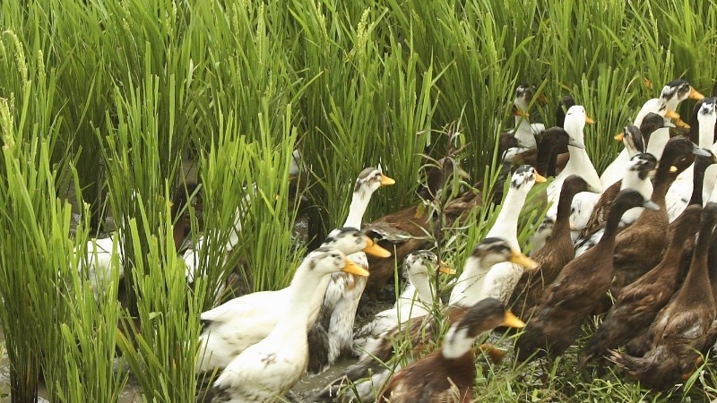
Duck-Rice-Fish Case Study
Photo credit: Greenpeace East Asia, 2011.

